Slide 1

Dawn R. Short
EDLD 5320: COVA + CSLE Capstone
M. Ed. Applied Digital Learning (ADL)
Lamar University

Slide 2
COVA Reflection and Application
COVA + CSLE
The Advisor That Cares | advising.blog
2

Slide 3

COVA + CSLE Learning
  COVA: choice (c), ownership (o), and voice (v) in an authentic (a) learning environment
  CSLE: creating (c) significant (s) learning (l) environments (e)
Over the last two years COVA + CSLE have aided my learning process by quite effectively, igniting my learners mindset.
COVA + CSLE
The Advisor That Cares | advising.blog
3

Slide 4

Learners mindset
  Growth Mindset: adopting a growth mindset (accepting failure) was vital to persevering in a program with limited instructions and a self-serve approach to learning.
  Learners’ Mindset: a childlike wonder for learning. An unquenchable desire to learn and do more and an intrinsic motivation to seek and find information.
A learner's mindset is messy and comes with mistakes, but it is active and alive with a thirst for more information and understanding.
COVA + CSLE
The Advisor That Cares | advising.blog
4

Slide 5
COVA AIDED MY LEARNING
Authentic
Purpose
Vulnerable
COVA + CSLE empowered me to create an innovation project that provides a real solution to the daily challenges advisors face. Because my innovation is real to me, I am constantly thinking of ways to evolve and improve upon it. Because my project personal, I am highly motivated to learn more to continue improving on my ideas.
Learning about Simon Sinek’s “why” and Daniel Pink’s “what motivates,” I became determined to dig deep and connect with the reasons I wanted to change the world for learners, starting with my immediate area of influence. As I reflected, I recognized that my purpose is to love people and help them along their journey. Applying COVA + CSLE helps me do exactly that.
The most considerable impact COVA + CSLE has was the personal vulnerability I experienced. I had to wrestle with a new way of learning and self-assess myself constantly. I found excitement in learning again. I revisited my past and overcome my limiting beliefs about learning. I also have the privilege to share these revelations with others in my reflections.
COVA + CSLE
The Advisor That Cares | advising.blog
5

Slide 6






E-PORTFOLIO
An ePortfolio (eP) can serve as a digital evidence of learning. Mine is not only where I explore my project, but it is also where I am piloting my innovation ideas.
Throughout the ADL Program, the reflection and personal exploration of my ideas, projects, and collaborations have made this learning opportunity a transformative one.
COVA + CSLE
The Advisor That Cares | advising.blog
6

Slide 7
A PERSONAL/PROFESSIONAL EVOLUTION
Voice
Focus
Attitude
Creating my ePortfolio (eP) required a great deal of self-evaluation and organizational observation. I was challenged to look at my organization and identify the most impactful change I could make for the betterment of others. Once I identified the purpose, I could refine the audience and message.
The objective of looking within my organization was an overwhelming one but also a personally meaningful one. It is difficult to be the voice of change, but my advising and personal philosophies call me to advocate for those who cannot advocate for themselves until they are empowered to do so. Once I connected with my why “to care about others” I had my focus.
I am inspired by the call to revolutionize advising by humanizing relationships through technology, I genuinely want to transform the advising relationships within my organization. I am excited by the possibilities of helping others see that they, too, can change the world one learner at a time by focusing on the learning.
COVA + CSLE
The Advisor That Cares | advising.blog
7

Slide 8


Collectives and Reflections
Collectives
Reflection
Reflection through this significant learning experience has been a critical component for processing my thoughts, feelings, curiosities, and ideas on everything I am learning. I utilize blogging to explore my innovation ideas and incorporate the skills and knowledge I learn in the program.
The New Culture of Learning impressed upon me the impact of learning collectives. My innovation ideas began to include thoughts on incorporating peer resources and imagined ways to create learning communities like the collaborative groups I am experiencing.
The ways that I contribute to the learning of my classmates through feedforward allow me to experience the influence of peer learning and showed me the value of this type of support and collaboration.
Reflecting on the ways that I contribute to my learning has been an extremely valuable accountability piece that I would like to incorporate into my learning environment. Self evaluation has deepened my learning experience.
COVA + CSLE
The Advisor That Cares | advising.blog
8

Slide 9

Learning philosophy
  Personal Reflection: using my experience to fuel a passion to help others.
  Beliefs about Learning:
    Learning is individualized and internal
    Learning is active, authentic, and autonomous
    Learning requires relationship and reflection
The exploration of my beliefs about learning, allowed me to heal past hurts and drives a passion to humanize advising relationships so that others can enjoy learning the way COVA + CSLE allows.
COVA + CSLE
The Advisor That Cares | advising.blog
9

Slide 10

Applying
COVA + CSLE

Slide 11

Leverage Advising as a
Significant Learning Opportunity
Recognizing that the advising relationship presents an authentic learning opportunity, a COVA approach ensures that learners remain in control as they develop overtime with the guidance of a trusted mentor.
  Learner onboarding presents an opportunity to create a significant learning environment (CSLE) for incoming students.
  A focus on learning outcomes through a COVA approach provides learners with freedom while showing the relevance of the information available.
COVA + CSLE
The Advisor That Cares | advising.blog
11

Slide 12

Roles and Relationships
  Advisors Role: an advisor’s role is to facilitate communication and help learners define meaning throughout their education. Advisors equip students with information, policy, and procedure.
  Advisees Roles: a learners role is to embrace the learning opportunity that college provides and take ever increasing responsibility for their path to degree completion.
By extending the advising relationship beyond synchronous meetings advisor and advisee can have more in-depth discussions that guide students toward their goals and clarify their paths which fortifies the advising relationship.
COVA + CSLE
The Advisor That Cares | advising.blog
12

Slide 13
Applying COVA + CSLE
Innovation to Advising
Advising 101 Course Design
Professional Learning
Experience COVA through a personally curated advising resource that flips advising to create an authentic learning opportunity through self-service tips and information.
Through deliberate instructional design an onboarding advising course gives learners choice, ownership, and voice as they explore orientation to LU.
COVA + CSLE is utilized in professional development opportunities with thoughtful planning, active participation, repeated practice, and ongoing support.
COVA + CSLE
The Advisor That Cares | advising.blog
13

Slide 14



Using COVA to build A CSLE
Advising Innovation
As evidenced by my publication submission, I embrace the COVA approach to learning.
I openly invite others to consider that CSLE humanizes the advising relationship through technology.
COVA + CSLE
The Advisor That Cares | advising.blog
14

Slide 15
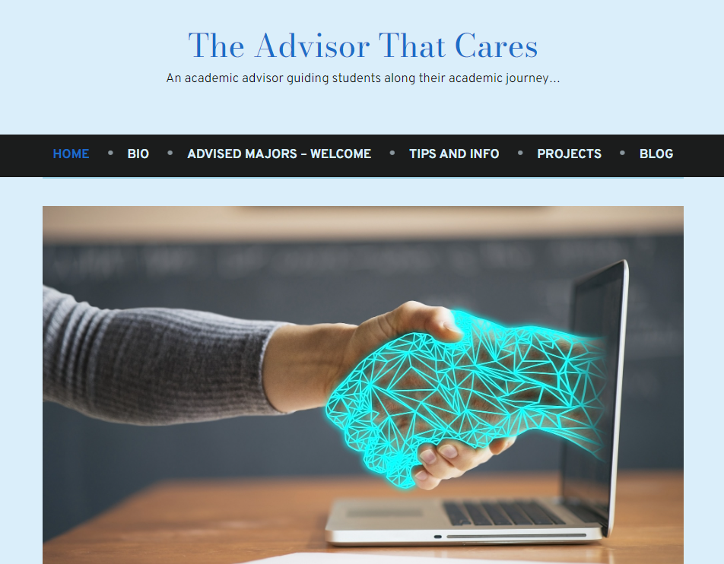
Join the Advising revolution
advising.blog
15

Slide 16
References
Harapnuik, D. (2022, September 23). Using the learner’s mindset – how and why this works. It’s About Learning. https://www.harapnuik.org/?p=9279
Harapnuik, D. (n.d.). Applied digital learning. It’s About Learning. https://www.harapnuik.org/?page_id=8517
Harapnuik, D., Thibodeaux, T., & Cummings, C. (2018). Choice, ownership, and voice through authentic learning. Creative Common License.
The Advisor That Cares | Dawn Short

